Slide 1
Chapter 2 - Linked Data Representations
CS2050 – Algorithm Design and Programming II

Slide 2
Linked Data Representations
What are they?
ADT’s – Abstract Data Types
ADT’s include linked-lists, queues, stacks, trees and more
There are different algorithms and requirements to implement each typ
Why use them?
They are a major topic of study in computer science
Very useful to organize data structures with algorithms
Can be used to overcome problems with predicting how much array space to allocate for tables and lists
“static” vs. “dynamic” memory use
Pointers are used to connect these separate blocks of storage
Very easy to add/change/delete blocks of data

Slide 3
Pointers – a review
Defining: int *fred; typedef int *IntegerPointer; IntegerPointer A, B;
The asterisk indicates that a type consisting of a “pointer” is being defined.
The values that can be stored in the variables fred, A, and B are now constrained.
fred, A and B MUST contain a memory address that “points” to other storage units
These other storage units MUST be integer types
REMEMBER – fred, A and B are VARIABLES just like int, float, long, double, char, etc. They hold memory addresses.

Slide 4
Pointers – a review
Pointers
Hold an address in computer memory
Are usually declared as a “type” of pointer (like int, long, double, char, etc.) although they can be a type of “void”
When defined they can be initialized to NULL or 0 or to a valid memory address
Are heavily used in advanced C programming with memory allocation, data structures, functions
Provide tremendous control and flexibility in programming
Examples: int a=7, b=4, *x; <- “x” is an integer pointer x = &a; <- the addr of “a” is loaded into “x”
*x=5; <- de-referencing the pointer printf(“The value is %d”, a);

Slide 5
Pointers – a review
#include <stdio.h>
int main( void )
{
int i = 5;
int *iPtr;
iPtr = &i;
printf("iPtr = %p address of i = %p\n\n", iPtr, &i);
printf("Address of iPtr = %p\n\n", &iPtr);
return 0;
}

Slide 6
Memory Allocation
You have allocated memory in CS1050. We’ve discussed this before: int a; float b; double c [ 10 ] = { 5.4, 3.3, 18.1, 9.0, 0.0 } ;
All of the above statements allocate memory. They do it statically.
Static vs. Dynamic
Static means “unchanging”, “fixed”, “stationary”
Dynamic means “constant change”, “very active”, “progress”
In your past programming you have been declaring static variables. Remember – I am talking about MEMORY, not the values in the variables. Static MEMORY.

Slide 7
Dynamic Memory
When you allocated an array in CS1050 int grades [ 10 ]; you could not change how many values it could hold after you compiled the program. In the example above you could only put 10 integers into the array “grades”.
That works fine if your application never needs more than 10 values in the array. If I work at a school and a teacher asks me to write a program to average 10 grades then this is perfect.
If another teacher wants to use the program and they have 20 students I’m in trouble. The program will have to be modified. So what? Just change it to [ 20 ] and recompile right?
There are two HUGE problems with this
Now the teacher with only 10 students is wasting memory
A programmer (you!) is required to modify and recompile the program for future teachers and changes

Slide 8
Dynamic Memory
The “dynamic” way to do this memory allocation would be allocate memory only when you need it and only as much as you need AT EXECUTION TIME. Vs. compile time. Get it?
How??? One way is to use malloc()
Short for “memory allocation”
A function in C that will do the memory allocation for you
The malloc() function requires that you pass to it
The “type” of data you will store in the memory
The “amount” of memory you need
The malloc() function will
Attempt to allocate the amount of memory you want
Return back to you the ADDRESS (see: pointer) of where that memory is
All at EXECUTION time

Slide 9
Dynamic Memory Allocation Example
typedef int *IntegerPointer; IntegerPointer A, B
A = (IntegerPointer) malloc(sizeof(int)); B = (int *) malloc(sizeof(int)); *A = 5; *B = 17; printf(“value is %d”, *A); printf(“address is %p”, A); free(A); free(B);

Slide 10
Dynamic Memory Allocation Example
#include <stdio.h>
#include <stdlib.h>
int main( void )
{
int numInts = 10, i, val;
int *arrPtr, *itemPtr;
printf("\n\nThe value of arrPtr = %p\n", arrPtr);
printf("The memory location for arrPtr = %p\n\n", &arrPtr);
arrPtr = malloc(numInts * sizeof(int));
printf("arrPtr = %p, size of int = %lu\n", arrPtr, sizeof(int));
printf("The memory location for arrPtr = %p\n\n", &arrPtr);
for ( i = 0; i < numInts; i++)
{ itemPtr = arrPtr + i;
val = i * 10;
printf("Storing %i at memory location = %p\n", val, itemPtr);
*itemPtr = val;
}
for ( i = 0; i < numInts; i++)
{ itemPtr = arrPtr + i;
printf("%i: value = %i at memory location = %p\n", i, *itemPtr, itemPtr);
}
for ( i = 0; i < numInts; i++)
{ printf("%i: value = %i\n", i, arrPtr[i]);
}
free(arrPtr);
return 0;
}

Slide 11
Dynamic Memory
Dynamic memory allocation is temporary
The memory can be accessed and used from the time it is allocated “malloc()” until the time it is released “free()”
#include <stdio.h>
#include <stdlib.h>
int main( void )
{
int* p = NULL;
allocate(&p);
*p = 42;
printf("The value it points to is %d",*p);
free(p);
}
void allocate(int** p)
{
*p = (int*)malloc(sizeof(int));
}

Slide 12
Pointers to Pointers to Pointers to...
Pointers can point to any data type
int, double, float, long, char, data structures, etc.
They can also point to other pointers – why would you do this?
When you do this you MUST be careful with the asterisk “*” and how/when it is used. Nothing you’ve learned so far changes here but it gets a lot more complicated when dealing with double, triple pointers and paying attention to the asterisk and how it is used. int *fred; <-the asterisk is used to define the pointer int a=7; fred = &a; <-an address is put into the pointer *fred = 7; <-we dereference the pointer and assign a value to that location (where fred points)

Slide 13
Pointers
The declaration of a pointer-to-pointer looks like this:
int **dpp; where the two asterisks indicate that two levels of pointers are involved. To demonstrate the use of dpp we can declare some pointers for it to point to and some ints for those pointers to point to: int a = 8, b = 11; c = 6; int *dp1 = &a, *dp2 = &b;
Now we can set dpp = &dp1; and dpp points to dp1 which points to a. *dpp is dp1, and **dpp is a, or 8.
a:
8
b:
11
c:
6
dp1:
dp2:
dpp:

Slide 14
More
If we say *dpp = dp2;
we've changed the pointer pointed to by dpp (that is, dp1) to contain a copy of dp2, so that it (dp1) now points at b:
a:
8
b:
11
c:
6
dp1:
dp2:
dpp:
If we say *dpp = &c;
we've changed the pointer pointed to by dpp (that is, dp1 again) to point to c:
a:
8
b:
11
c:
6
dp1:
dp2:
dpp:

Slide 15
Another program
char *str[5]; //5 strings in an arraychar
Char *p_str, *p_str2;
str[0] = "This is string number 1.";
str[1] = "This is string number 2.”;
p_str = str[0];
p_str2 = str[1];
puts(p_str);
puts(++p_str);
puts(p_str2);

Slide 16
Creating a Linked List ADT
So far, we’ve done a lot of pointer work and malloc() with primitive data types.
Why not do the same with a data structure? How does this work? struct node { int data; struct node *nextPtr; } ;
This is a DEFINITION of a structure. It does not allocate memory. It merely defines a new “type”. Now the program has types int, double, float, long, char and “node” available.
Allocating memory for the structure would be struct node newPtr = (struct node *) malloc (sizeof (node));

Slide 17
malloc() Issues – CAUTION!
A structures size is not necessarily the sum of the size of its members!
There may be “gaps” due to word alignment restrictions on different systems
Use the “sizeof” operator to determine the size of a structure
Test for a “null pointer” return value when using malloc() to determine if the space was allocated
Not returning dynamically allocated memory when you know longer need it could cause the system to run out of memory and crash
“memory leak” is a common term for this
Use the “free” operator to free up memory

Slide 18
Dynamic Memory Allocation (Cont.)
The allocated memory is not initialized.
If no memory is available, malloc returns NULL.
Function free deallocates memory—i.e., the memory is returned to the system so that the memory can be reallocated in the future.
To free memory dynamically allocated by the preceding malloc call, use the statement
free( newPtr );
C also provides functions calloc and realloc for creating and modifying dynamic arrays.

Slide 19
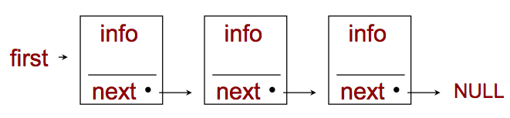
A Linked List ADT
A linked list is a collect of structures (of the same type) that have a pointer embedded that points to the next structure in the list
In this example “first” is a pointer that has the address for the first node in the list
“next” is a pointer INSIDE the structure that has the address for the next structure in the list

Slide 20
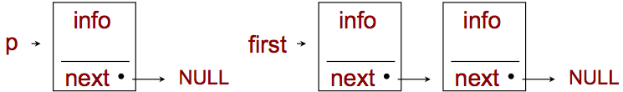
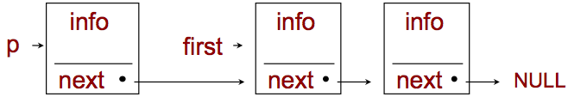
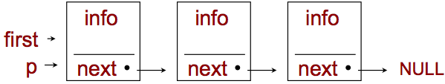
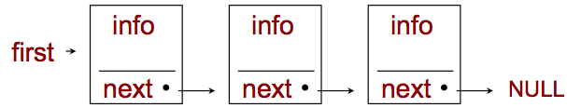
A Linked List ADT – Adding a node
First - allocate memory for the new node (left diagram) and set the pointer to NULL
Then set p.next to first (another pointer of type node)
Then set “first” equal to “p” to complete the insertion

Slide 21
Linked Lists (continued)
Linked list nodes are normally not stored contiguously in memory
LOGICALLY, however, the nodes of a linked list appear to be continguous
Linked lists can be maintained in sorted order by inserting each new element at the proper point in the list
Would creating a list in sorted order improve searching performance?

Slide 22
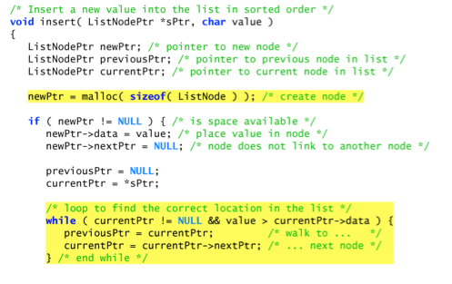
Inserting a node into a list in sorted order

Slide 23
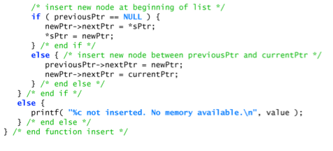
Inserting a node into a list in sorted order

Slide 24
Common Linked List Problems
Dangling Pointers
Not keeping track of pointers and they end up pointing to memory that has been “free()”ed. When you call “free()” make sure you clean up the pointers.
Memory Leaks
Covered that. Not using “free()” when finished with memory
Dereferencing a “NULL” pointers – running off the end of a list
Forgetting to use “NULL” to indicate the end
Detecting storage allocation failure – from malloc()
Watching out for “boundary” cases
How to you handle an empty list in your algorithms?
Does your list have an application limit?

